Slide 1
TOURISM TRAVEL WEBSITE
su
Under the supervision of
Mr.Bediga Sharan
Associate Professor School of
Computer Science & Artificial Intelligence
Presented for
Milestone 3-Final Minor Project Review
Date:26-04-2024
Candidate No. & Name
HTNO. | Name
2203A51L84 2203A51L69 2203A51L02 2203A51L11 2203A51L38 | K.RISHITHA D.VARSHITHA A.HARSHHITHA D.TAGORE M.HARSHITH

Slide 2
Outline of the Presentation
1.Abstract
2. Introduction
3.Objectives
4.Literature survey
5.Existing system
6.Disadvantage
7.Existing methodology
8.Gaps identified
9.Problem Identification
10.Proposed Methodology
11.Architecture of proposed system
12.Implementation and Results
13.Conclusion and Future Scope

Slide 3
Abstract
Travel and tourism website is used to book a tour from anywhere in world by a single dynamic website which will help the user to know all about the places and tour details in a single website. The admin can add packages to the website from a certain travel agents and hotels by create a tour page. Then the users can sign in and book each project, they can be confirmed by the admin in their manage booking page. The user can see the confirmation in their my booking page.

Slide 4
Introduction
Travel and tourism website is used to book a tour from anywhere in the world by a single dynamic website which will help the user to know all about the places and tour details in a single website. The admin can add packages to the website from a certain travel agents and hotels by create a tour page. Then the users can sign in and book each project, they can be confirmed by the admin in their manage booking page. The user can see the confirmation in their my booking page. It is a easiest platform for all travelers which can be easily booked and know the all details. It is dynamic and responsive web design. It is also called travel technology solution for agencies & tour operation. Nearly Everyone goes on a vacation for this ‘a Tourism travel website’ would play a vital role in planning the perfect trip.

Slide 5
Objectives
To streamline operations, enhance efficiency, and elevate customer satisfaction within the travel and tourism industry by providing a robust platform for managing reservations, tracking itineraries, optimizing resource allocation, and facilitating seamless communication between stakeholders, ultimately fostering a memorable and hassle-free travel experience for both travelers and service providers

Slide 6
Literature Review
Information and navigation system were designed for tourists, taking some Niger state of
Nigeria tourism destinations into account. The information management system was designed using Java
Hypertext Mark Up Language (HTML), Personal Home Page (PHP), Java script and
MySQL as the back-end integration database. Two different MySQL servers were used, the MySQL query
Tourism's economic contribution earns it respect among other industries in the Ile-Ife community, as well as
concern from businesspeople, tourists, government officials, and the general public. Personal surveys and random administration of questionnaires on respondents in the four Local Government.

Slide 7
Existing system
In the existing system, travelers had to carry their tasks manually. In past system travelers had a list of
destination and package details manually in paper, which was time taking. The travelers aren't ready to achieve
their need in time and also the results might not accurate. Because of the manual human work there comes
number of difficulties and drawbacks in this system. Some of them are Drawbacks of the Existing System:
• Maintenance becomes difficult, since there is huge amount of data that user carry.
• If any admin, user entry is wrongly made then the maintenance becomes very difficult

Slide 8
Disadavantages
Dependency on Technology: Travel websites rely heavily on technology, which means they can be susceptible to technical issues such as server crashes, website glitches, or slow loading times. This can frustrate users and potentially lead to lost business.
Information Overload: With so much information available on travel websites, users may feel overwhelmed and find it difficult to make decisions. Sorting through countless options for flights, accommodations, activities, and attractions can be time-consuming and confusing.
Potential for Misinformation: Not all information on travel websites is accurate or up-to-date. Listings for hotels, restaurants, and attractions may be outdated or biased, leading to disappointment for travelers who rely on them.

Slide 9
Existing Methodology
Search and Discovery :
Travel websites use search engines that allow users to find flights, hotels, and attractions based on various criteria like destination, date, and budget. They may also employ filtering and sorting options to refine search results.
Content Management & Booking and Payment Systems:
Travel websites provide rich content like destination information, photos, videos, and travel blogs to inspire and educate users about potential trip options. Secure online booking systems allow users to reserve flights, hotels, and activities directly through the website .Integration with payment gateways facilitates secure transactions.
Account Management:
User accounts enable features like storing preferences, tracking past bookings, and managing travel documents.

Slide 10
Gaps Identified
Lack of Real-Time Updates:
Timely and accurate information is crucial in the dynamic travel industry, but some management systems may struggle to provide real-time updates on inventory availability, pricing, and promotions. This can lead to missed opportunities and dissatisfaction among travelers and businesses.
Poor User Experience:
User interfaces and workflows in travel management systems may be complex, unintuitive, or outdated, leading to frustration and reduced productivity for users.
Insufficient Analytics and Reporting:
Many travel management systems provide basic reporting capabilities, but may lack advanced analytics features to derive actionable insights from data. This hampers strategic decision-making and optimization of business processes.

Slide 11
Problem statement and solution
Promote tourism in different periods (for example out of season) and at different times from the most popular. Create new and different itineraries and tourist attractions. Review and improve regulations, such as closing some overcrowded areas to traffic. Attract more responsible types of traveler.
The goal of tourism management is to ensure that all aspects of the tourism experience run smoothly and efficiently, while also providing a high level of customer satisfaction. In order to be successful, tourism managers need to have a good understanding of the tourism sector as a whole.

Slide 12
Proposed Methodology
The proposed system is designed to outperform the manual system. It facilitates all basic tasks that are now
carried out manually. The proposed System is completely web-Based application. A Lot number of records can
be searched and displayed without taking much time.
Gives accurate information
• Simplifies the manual work
• It minimizes the documentation related work
• Provides up to date information
• Friendly Environment by providing warning messages.
• Traveler’s details can be provided
• Booking confirmation notification

Slide 13
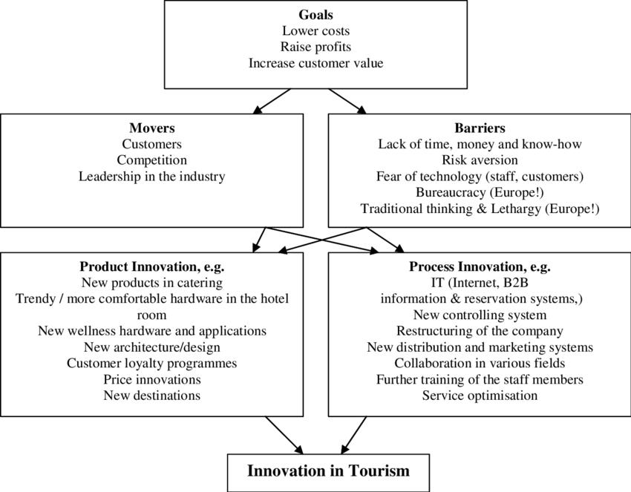
Architecture of proposed system

Slide 14
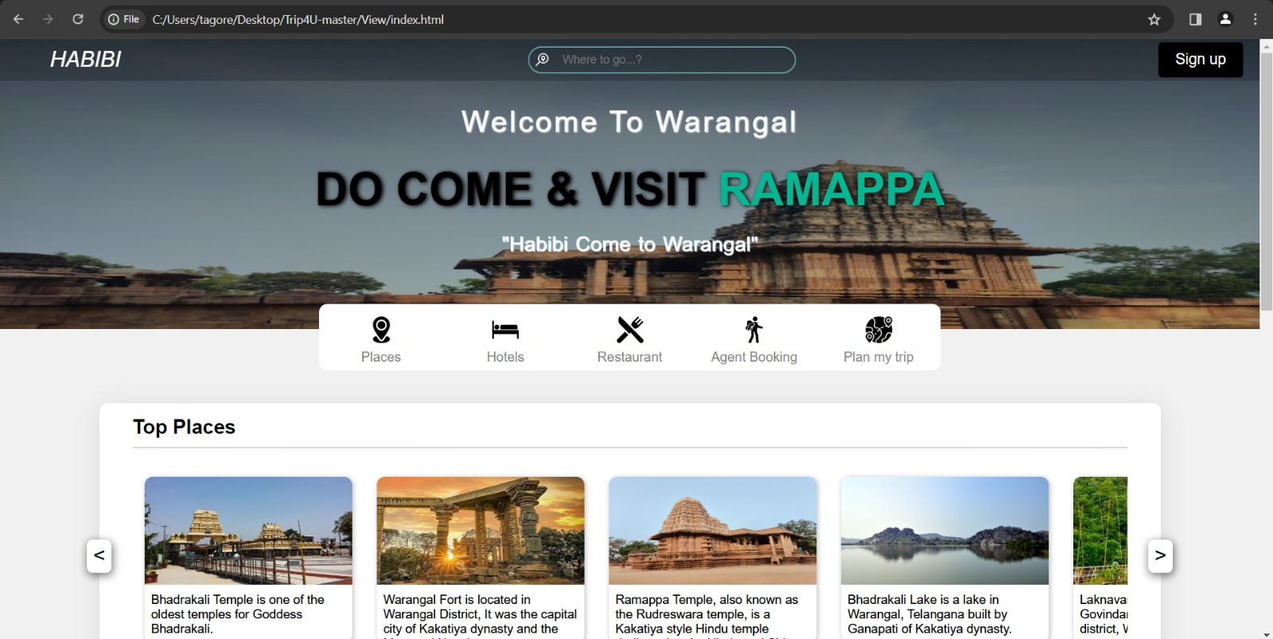
Implementation and results

Slide 15
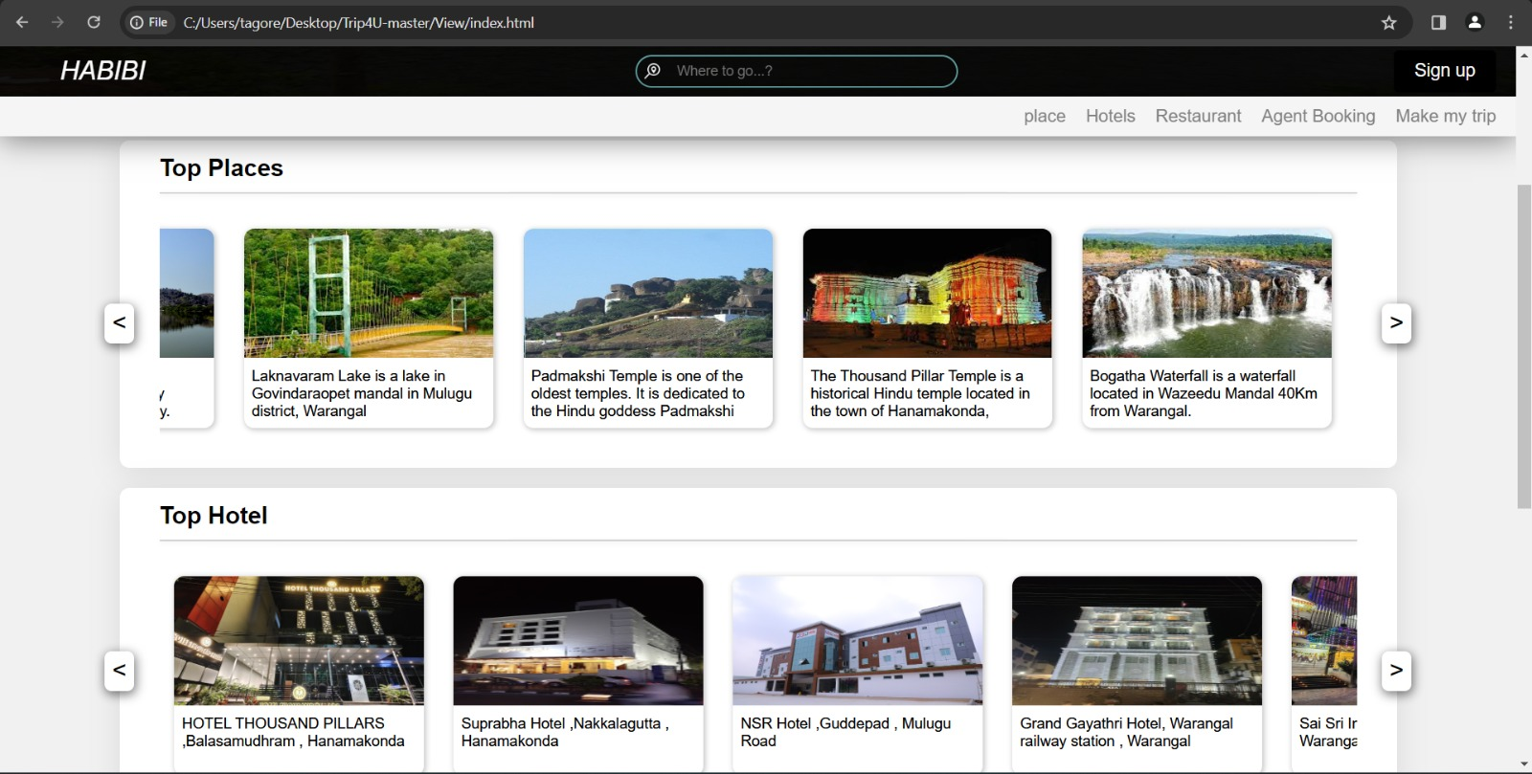

Slide 16
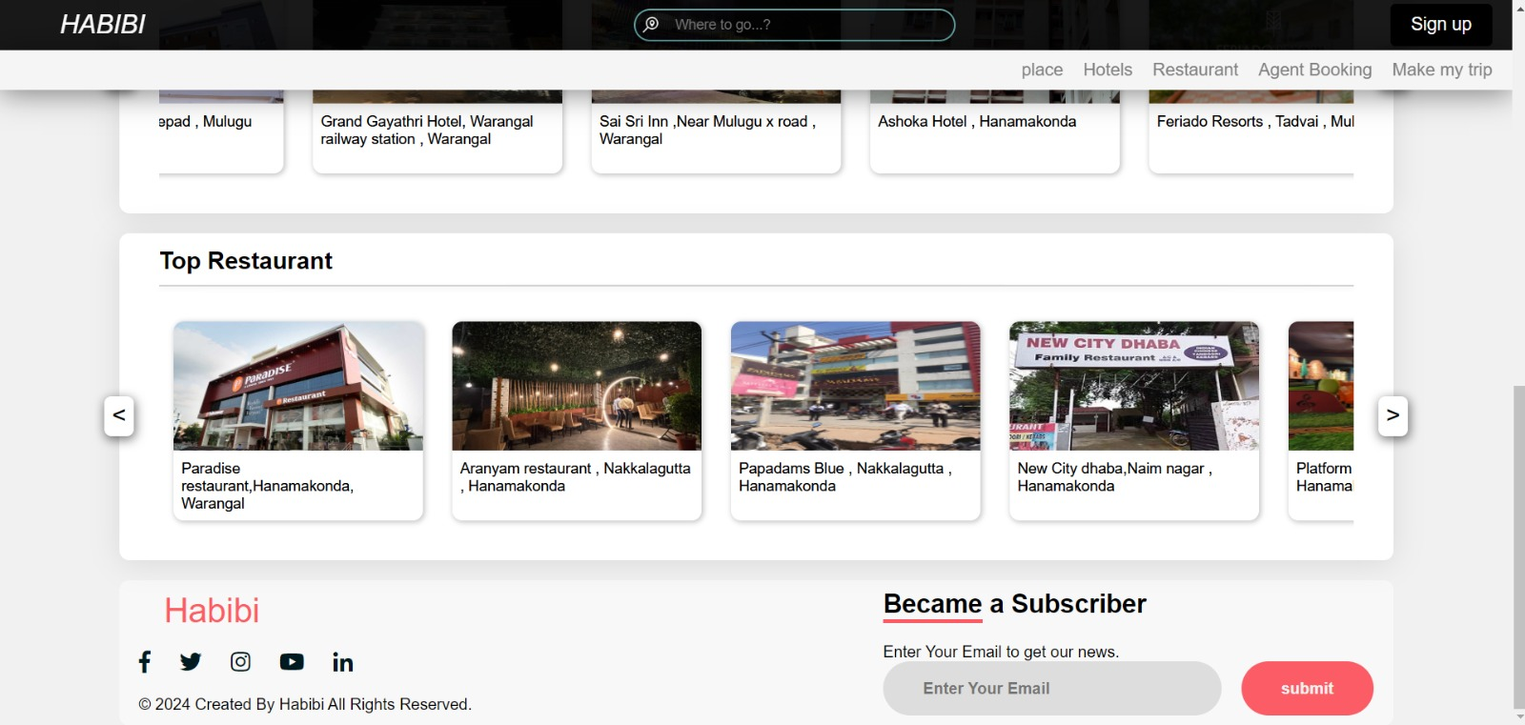

Slide 17
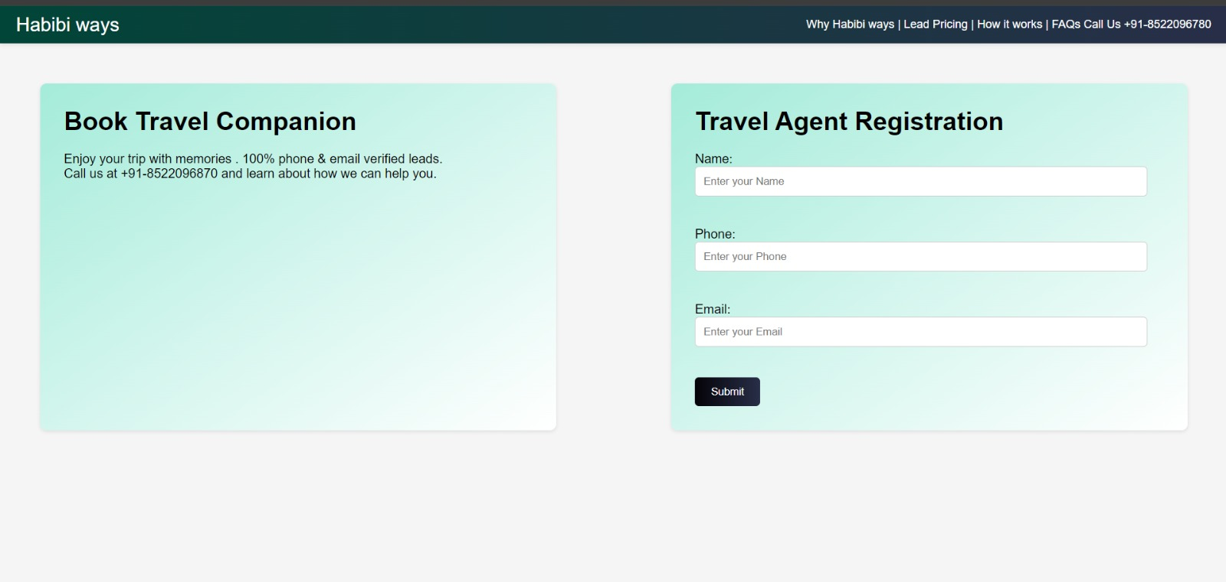

Slide 18
Conclusion and Future scope
Day by day travel is known as a global trade which is extremely increasing at a great flow like other trade. There are many various activities are occurring in tour functions. Our ‘Travel and Tour website’ is a web-based application that benefits in the online order of travel packages, hotels, transfers, etc. It has a well disposed climate that interfaces with clients readily. At long last, we can say that this Web Based Application will help the travel administrators to manage and control tour-related initiates successfully and productively. It provides an easy route to automate all the functionalities of expense. If this system is executed in a few tuberculosis, it will be effective. It is presumed that the application functions admirably and fulfills the requirements. It additionally goes about as the sharing of documents too significant assets. In the future, we are going to develop this project on a web page. Also, we will try to add more features to this application according to demand. In future development, we will provide location-based service.

